Slide 1
CPSC 481 Artificial Intelligence
Mr. Ayush Bhardwaj
abhardwaj@fullerton.edu

Slide 2
What we will cover today
Uninformed search
Depth first search
Depth limited search
Breadth first search
Iterative deepening
Search algorithm properties

Slide 3
Searching a graph: the challenge
Number of nodes is practically infinite
Cannot pre-compute all nodes and store it in a computer/data structure
“Search”, not a “traversal”
Nodes can reappear in the search
Possible to get into loops

Slide 4
Problem to solve
Represented by a four-tuple [N,A,S,GD], where:
N: the problem space, set of vertices
A: the set of edges between vertices
the moves in a game (“operators”/ “actions”)
S: the start state of the problem
Initial board position of the game
GD: the goal state(s) of the problem
Checkmate in chess, all numbers sorted in sliding tile puzzles

Slide 5
Depth-first TREE search
Input: A problem
Data structure: frontier
Also called “open”
Stack, LIFO queue
Initialize frontier with initial state
Loop do
IF the frontier is empty RETURN FAILURE
Choose top node and remove it from frontier
IF top node is goal RETURN SUCCESS
expand top node: pushing child nodes to the frontier

Slide 6
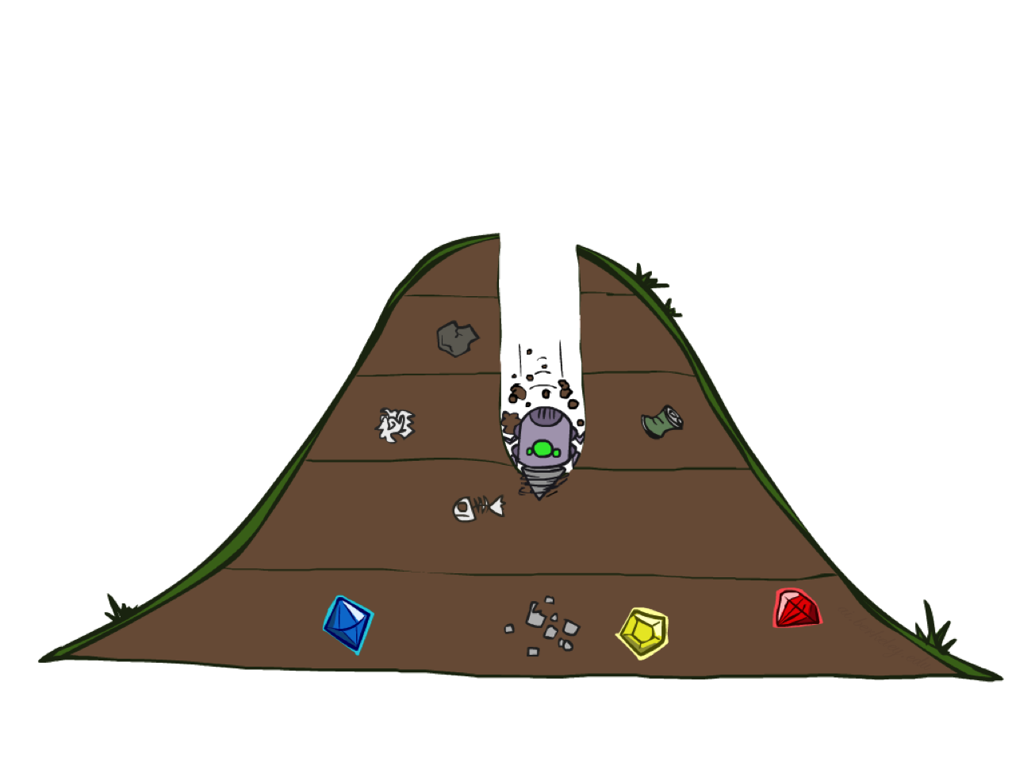
Depth-First Search

Slide 7
Initial state: A
Goal state: D
Using DFS (Tree version)
Expand child nodes in alphabetical order
1. List states as they are expanded
2. Show frontier/stack at every step
A
C
B
G
D
F
Expanded node | Frontier
- | A
… | …
E
Notes:
A, C, G, F, B, E, F, C, G, D

Slide 8
Initial state: A
Goal state: D
Using DFS (Tree version)
Expand child nodes in alphabetical order
List states as they are expanded
Show frontier at every step
A
C
B
G
D
F
E
F
List of states:
B
A
C
G
Frontier
Notes:
A, C, G, F, B, E, F, C, G, D

Slide 9
Initial state: A
Goal state: D
Using DFS (Tree version)
Expand child nodes in alphabetical order
List states as they are expanded
Show frontier at every step
A
C
B
G
D
F
E
List of states:
E
D
A
C
G
F
B
Frontier
Notes:
A, C, G, F, B, E, F, C, G, D

Slide 10
Classwork
On Google Drive
Link on Canvas
Go to today’s date and section
Editable and viewable by all
Create a new Google Document and name it with your groupmates’ names
E.g.: Garcia-Joshi-Nguyen
Write the names and role of group members
Roles: manager, recorder+presenter, timekeeper
Add your answers
Will not be graded but used for class participation points
Can easily share with rest of class outside the breakout room

Slide 11
Depth-first TREE search
Redundant paths
Some states can be reached in more than one way

Slide 12
Initial state: A
Goal state: D
Using DFS (Tree version)
Expand child nodes in alphabetical order
1. List states as they are expanded?
2. Show frontier at every step?
A
C
B
G
D
F
E
Notes:
A, C, G, F, B, E, F, C, G, D

Slide 13
Depth-first TREE search
Redundant paths
Some states can be reached in more than one way
TREE search can visit the same state multiple times via redundant paths
Loopy paths
A special case of redundant paths

Slide 14
Search Algorithm Properties
Complete: Guaranteed to find a solution if one exists?
Optimal: Guaranteed to find the least cost path?
Time complexity
Space complexity
Cartoon of search tree:
b is the branching factor
m is the maximum depth
solutions at various depths
Number of nodes in entire tree?
1 + b + b² + …. b^{m} = b^{m+1} = O(b^{m})
b
1 node
…
b nodes
b² nodes
m tiers
b^{m} nodes

Slide 15
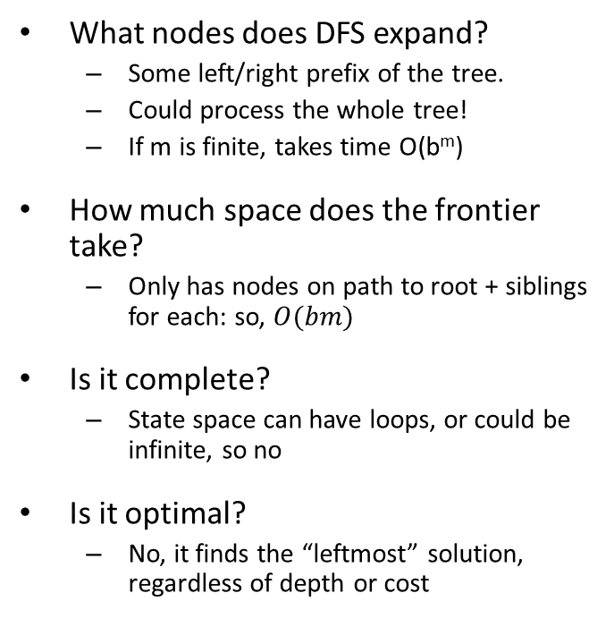
Depth-First Search (DFS) Properties
What nodes does DFS expand?
Some left/right prefix of the tree.
Could process the whole tree!
If m is finite, takes time O(b^{m})
How much space does the frontier take?
Only has nodes on path to root + siblings for each: so, $O(bm)$
Is it complete?
State space can have loops, or could be infinite, so no
Is it optimal?
No, it finds the “leftmost” solution, regardless of depth or cost
b
1 node
…
b nodes
b² nodes
m tiers
b^{m} nodes

Slide 16
A
DFS is not complete if the state space is infinite
Initial state: A Goal state: D
C
B
G
D
F
E
Notes:
A, C, G, F, B, E, F, C, G, D

Slide 17
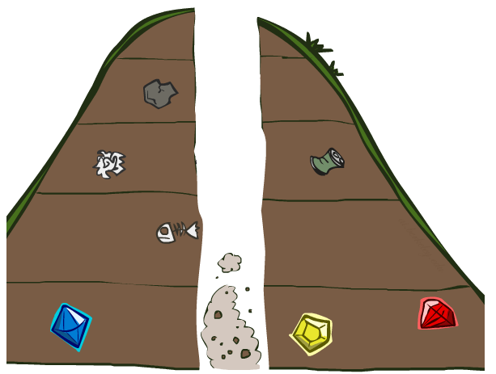
Search Algorithm Properties

Slide 18
Depth-first TREE search with loop checking
Input: A problem
Data structures:
frontier
Stack, LIFO queue
path from root to current node
Parent pointers
Initialize frontier with initial state
Loop do
IF the frontier is empty RETURN FAILURE
Choose top node and remove it from frontier
IF top node is goal RETURN SUCCESS
expand top node
push resulting nodes to the frontier IF they are not already on the path

Slide 19
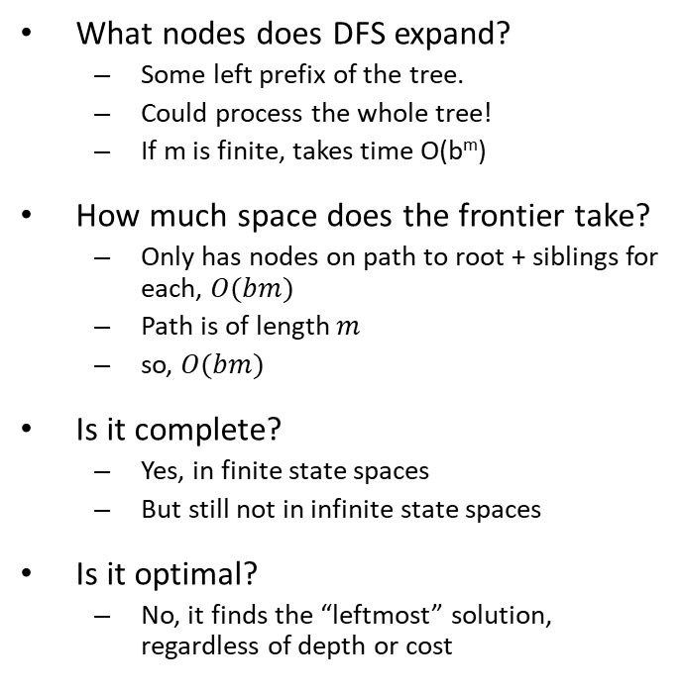
Depth-First Search with loop checking Properties
What nodes does DFS expand?
Some left prefix of the tree.
Could process the whole tree!
If m is finite, takes time O(b^{m})
How much space does the frontier take?
Only has nodes on path to root + siblings for each, $O(bm)$
Path is of length $m$
so, $O(bm)$
Is it complete?
Yes, in finite state spaces
But still not in infinite state spaces
Is it optimal?
No, it finds the “leftmost” solution, regardless of depth or cost
b
1 node
…
b nodes
b² nodes
m tiers
b^{m} nodes

Slide 20
Depth-first GRAPH search
Input: A problem
Data structure:
Frontier (also called “open”)
Stack, LIFO queue
Explored (also called “closed”)
Set, for efficiency
Initialize frontier with initial state
Initialize explored to empty
Loop do
IF the frontier is empty RETURN FAILURE
Choose top node from frontier and remove it
IF top node is goal RETURN SUCCESS
Add node to explored
expand node, pushing resulting nodes to the frontier only if not already on frontier or explored

Slide 21
Initial state: A
Goal state: D
Using DFS (Graph version)
Expand child nodes in alphabetical order
List states as they are expanded?
Show frontier, explored at every step?
A
C
B
G
D
F
E
Notes:
A, C, G, F, B, E, F, C, G, D

Slide 22
Initial state: A
Goal state: D
Using DFS (Graph version)
Expand child nodes in alphabetical order
List states as they are expanded?
Show frontier, explored at every step?
A
C
B
G
D
F
E
Frontier:[,
Explored: {A, C, G, F, B, E}
Notes:
A, C, G, F, B, E, F, C, G, D

Slide 23
Initial state: A
Goal state: D
Using DFS (Graph version)
Expand child nodes in alphabetical order
List states as they are expanded?
Show frontier, explored at every step?
A
C
B
G
D
F
E
Frontier:[D
Explored: {A, C, G, F, B , E }
Notes:
A, C, G, F, B, E, F, C, G, D

Slide 24
Depth-First Search (Graph version) Properties
Time complexity
Limited by the state space
Can be much smaller than O(b^{m})
How much space does the algorithm take?
All expanded nodes will be added to explored
so, O(b^{m})
Is it complete?
Yes, in finite state spaces
But still not in infinite state spaces
Is it optimal?
No, it finds the “leftmost” solution, regardless of depth or cost
b
1 node
…
b nodes
b² nodes
m tiers
b^{m} nodes

Slide 25
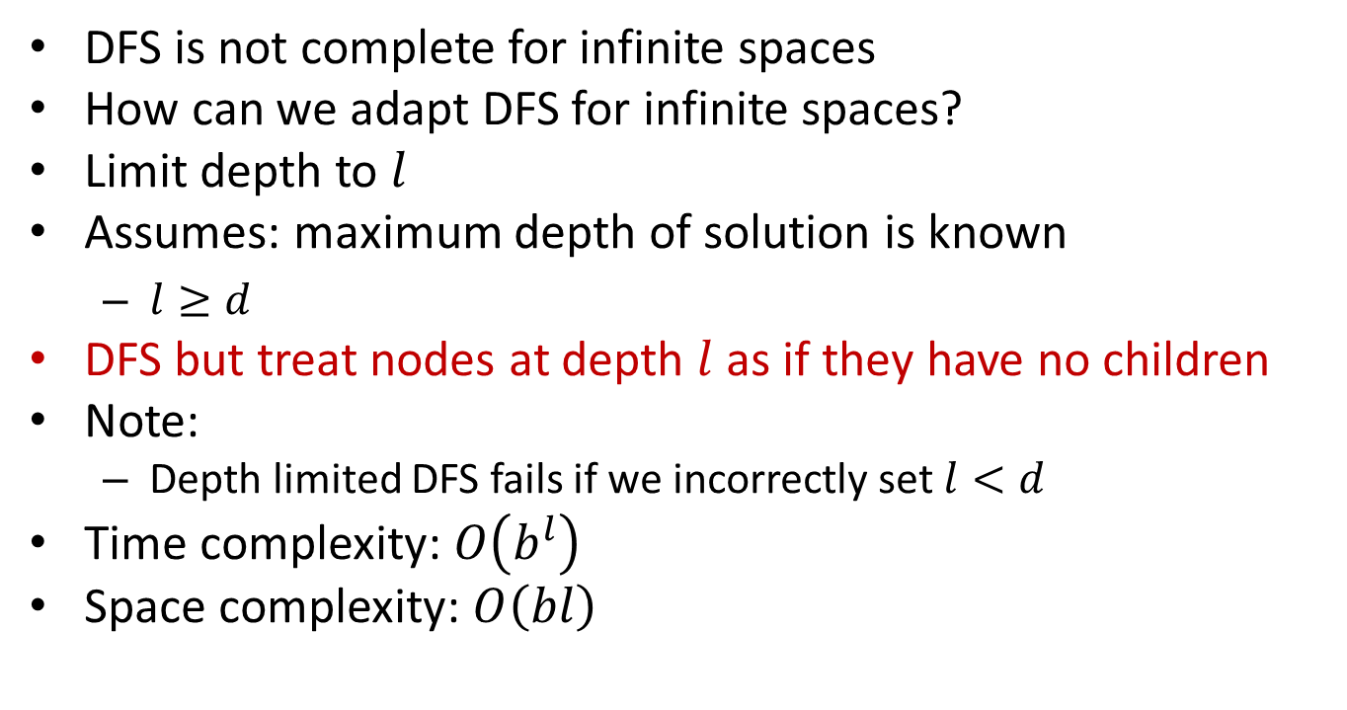
Depth limited DFS
DFS is not complete for infinite spaces
How can we adapt DFS for infinite spaces?
Limit depth to $l$
Assumes: maximum depth of solution is known
$l≥d$
DFS but treat nodes at depth $l$as if they have no children
Note:
Depth limited DFS fails if we incorrectly set $l<d$
Time complexity: $O\left(b^{l}\right)$
Space complexity: $O\left(bl\right)$

Slide 26
Depth-First Search
Strategy: expand a deepest node first
Implementation: Fringe is a LIFO stack
a
G
a
c
b
c
b
e
d
e
d
f
f
S
h
h
p
p
r
q
r
q
S
d
e
p
b
c
e
h
r
q
a
a
h
r
p
q
f
p
q
f
q
c
G
q
c
G
a
a

Slide 27
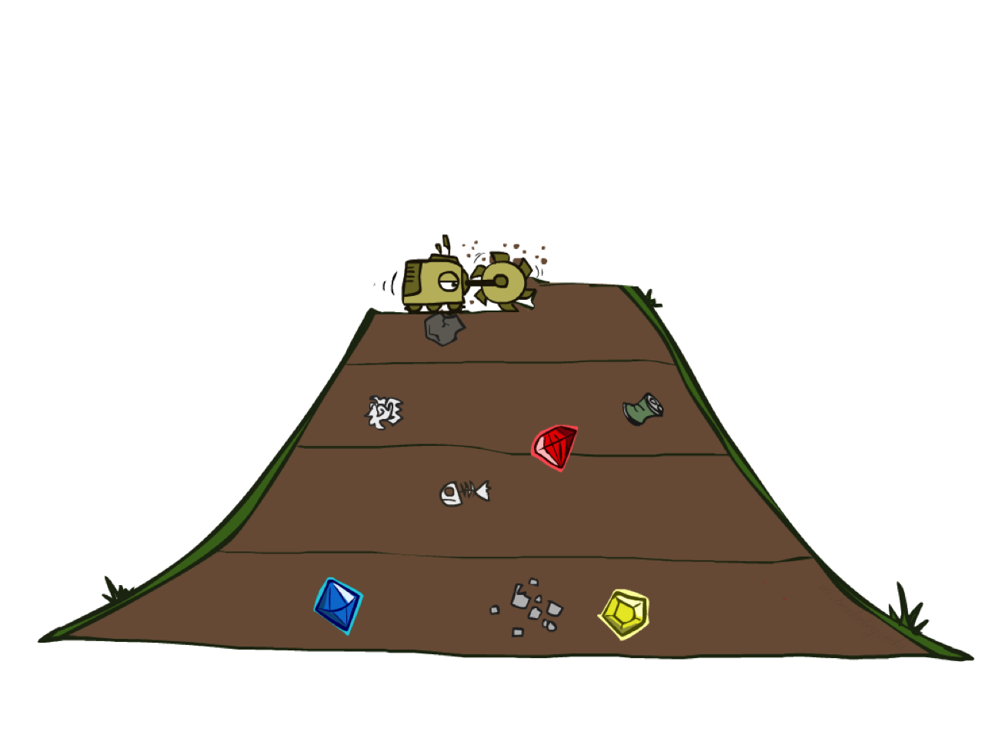
Breadth-First Search

Slide 28
Breadth-first graph search
Input: A problem
Data structures:
Frontier (also called “open”)
Queue, FIFO queue
Explored (also called “closed”)
Set, for efficiency
Initialize frontier with initial state
Initialize explored to empty
Loop do
IF the frontier is empty RETURN FAILURE
Choose front-node from frontier and remove it
Add front-node to explored
FOR every child-node of front-node
IF child-node not already on frontier or explored
IF child-node is goal RETURN SUCCESS
push child-node to frontier

Slide 29
Initial state: A
Goal states: F, H
Using BFS
Expand child nodes in alphabetical order
List states as they are expanded?
Show frontier, explored at every step?
A
C
B
G
D
F
E
H
B
C
A
Notes:
A, C, G, F, B, E, F, C, G, D

Slide 30
Breadth-First Search
Strategy: expand a shallowest node first
Implementation: Fringe is a FIFO queue
a
G
b
c
d
e
f
S
h
p
q
r
S
d
e
p
Search
Tiers
q
b
c
e
h
r
a
a
h
r
p
q
f
p
q
f
q
c
G
q
c
G
a
a

Slide 31
Breadth-First Search (BFS) Properties
What nodes does BFS expand?
Processes all nodes above shallowest solution
Let depth of shallowest solution be s
Search takes time O(b^{s})
How much space does the frontier take?
Has roughly the last tier, so O(b^{s})
Is it complete?
s must be finite if a solution exists, so yes!
Is it optimal?
Yes, if costs are all equal
more on costs later
b
1 node
…
b nodes
s levels
b² nodes
b^{s} nodes
b^{m} nodes

Slide 32
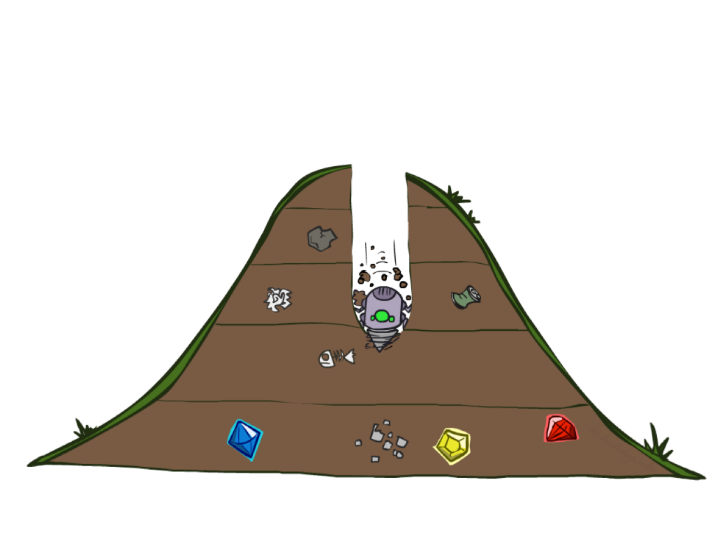
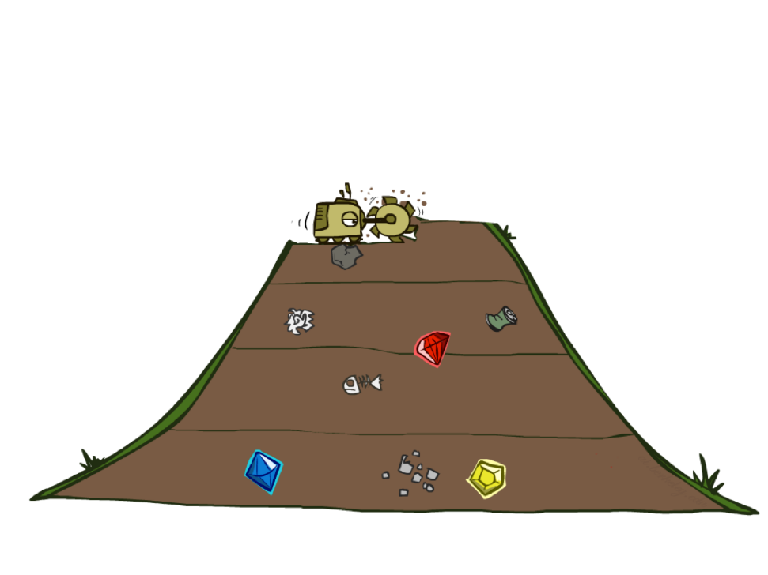
DFS vs BFS

Slide 33

Video of Demo Maze Water: BFS

Slide 34
Video of Demo Maze Water: DFS

Slide 35
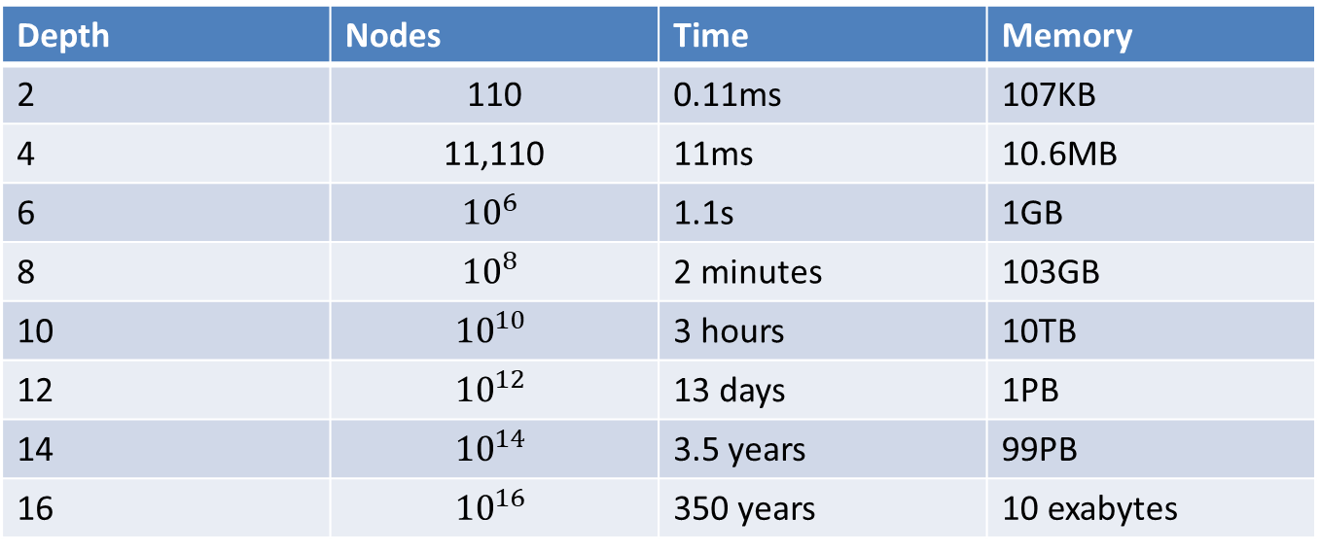
Time vs Space complexity
Depth | Nodes | Time | Memory
2 | 110 | 0.11ms | 107KB
4 | 11,110 | 11ms | 10.6MB
6 | $${10}^{6}$$ | 1.1s | 1GB
8 | $${10}^{8}$$ | 2 minutes | 103GB
10 | $${10}^{10}$$ | 3 hours | 10TB
12 | $${10}^{12}$$ | 13 days | 1PB
14 | $${10}^{14}$$ | 3.5 years | 99PB
16 | $${10}^{16}$$ | 350 years | 10 exabytes
b=10, computer generates 1 million nodes/second, 1KB per node in memory
Space requirement is a much more serious issue than time requirement

Slide 36
Iterative Deepening
Idea: get DFS’s space advantage with BFS’s time / shallow-solution advantages
Run a DFS with depth limit 1. If no solution…
Run a DFS with depth limit 2. If no solution…
Run a DFS with depth limit 3. …..
b
…

Slide 37
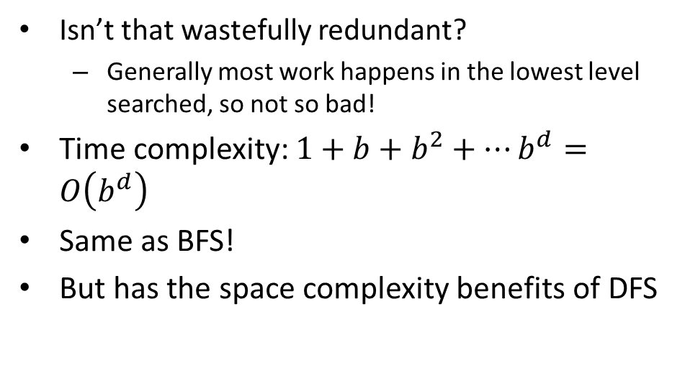
Complexity of Iterative Deepening
Isn’t that wastefully redundant?
Generally most work happens in the lowest level searched, so not so bad!
Time complexity: $1+b+b^{2}+…b^{d}=O\left(b^{d}\right)$
Same as BFS!
But has the space complexity benefits of DFS
b
…
In general, iterative deepening is the preferred uninformed search method when the search space is large and the depth of the solution is not known.

Slide 38
Search Directions in a State Space
Data-driven (or forward)
Use the knowledge and constraints found in each state of the problem to guide search by applying rules/methods to produce new states until it finds a goal state/solution.
Most problems can be solved via data-driven approach.
Goal-driven (or backward)
Use knowledge of the goal to guide the search by checking what rules/methods can be used to generate this goal and determine what conditions must be true to use them.
These conditions become the new goals/subgoals, and continue working backward until it works back to the facts of the problem.
Diagnosis, theorem proving, answering some multiple-choice questions, etc.
Note: Both approaches explore the same problem space.
Preferred strategy is chosen by the properties of the problem.
Factors to consider: complexity of search space
branching factor: branching factor can be different near the initial state and at the end states
Notes:
*Branching factors and amount of information determine the space to search

Slide 39
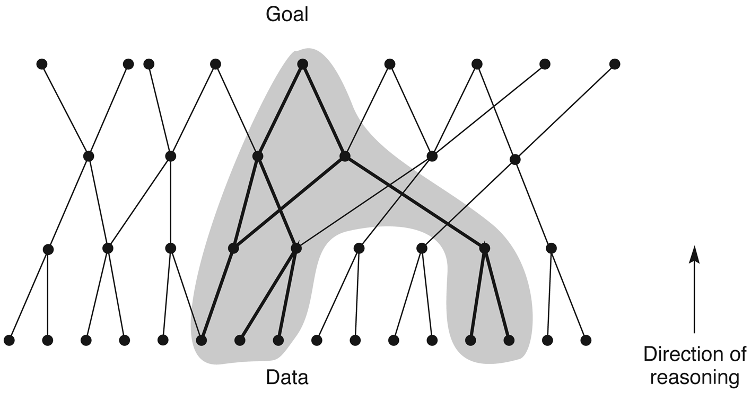
Data-directed search

Slide 40
When is the Data-driven Search Better?
When all or most of the data are given in the initial problem statement.
For many interpretation problems by presenting a collection of data and asking the system to provide a high-level interpretation
Systems analyze data (e.g., interpreting geological data to find minerals, PROSPECTOR)
When there are a large number of potential goals, but there are only a few ways to use the facts and given information of a particular problem instance.
DENDRAL expert system finds the molecular structure of organic compounds based on their formula, mass.
When it is difficult to formulate a goal or hypothesis.
Notes:
In general when: one initial state -> -> multiple next states and goals

Slide 41
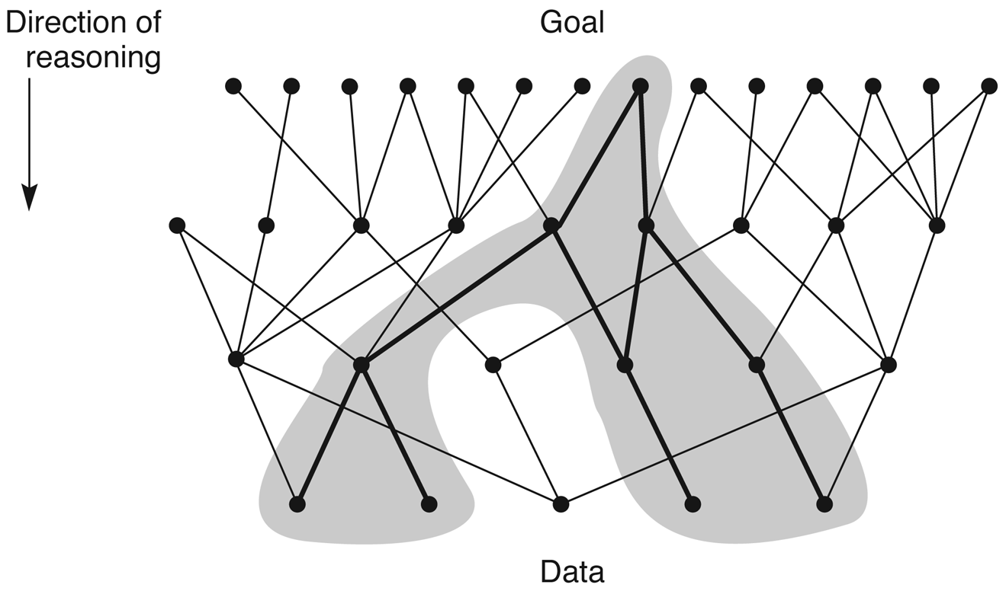
Goal-directed search

Slide 42
When is the Goal-driven Search Better?
Useful when the goal/hypothesis is already known or easily formulated and finding causes when something is already happened.
Theorem proving (goal is the theorem to prove), question answering in expert systems (questions are goals).
Problem data are not given but must be acquired by the problem solver.
Finding causes, e.g., medical diagnosis problem, doctor orders only those that are necessary to confirm or deny a particular hypothesis.
When there are a large number of rules that match the states of the problem and thus produce an increasing number of conclusions (for reduced search space).
Prove a statement “I am a descendant of Thomas Jefferson.”
Notes:
In general when: one initial goal -> -> multiple next states and conditions or causes

Slide 43
Class work
Consider the scenarios below and identify whether it is better to perform a data-driven or goal-driven search to solve the problem. Explain your answer.
Diagnosing mechanical problems in a car
Find the fastest path to travel from CSUF to your home
Hints:
First, what would be a state?
What would be the state space?
What are the operators?

Slide 44
References
George Luger, Artificial Intelligence: Structures and Strategies for Complex Problem Solving, 6th edition, Addison Wesley, 2009. Chapter 3.
Russel and Norvig, Artificial Intelligence: A Modern Approach, 3rd edition, Prentice Hall, 2010. Chapter 3.3

Slide 45
Acknowledgement
https://inst.eecs.berkeley.edu/~cs188/su20/

